Slide 1
Business Cycles, Aggregate Demand and Multiplier model
Aditi Chaubal
aditi@hss.iitb.ac.in
HS101 – Economics (Macroeconomics) - 2019

Slide 2
Recall…
Real GDP growth rate: % growth of real GDP
Economic growth: Economies generally exhibit a steady long-term growth in real GDP (despite fluctuations seen in business cycles) and an improvement in living standards; this process is known as economic growth.
Potential GDP (Y*): Represents the maximum sustainable level of output that the economy can produce.
At potential GDP, high levels of utilization of the labor force and the capital stock
Determinants: Productive capacity of the factors of production, technological efficiency with which the inputs are combined
HS101 – Economics (Macroeconomics) - 2019

Slide 3
Ref: Reserve Bank of India Online Database on the Indian Economy (RBI-DBIE)

Slide 4
Business cycles
Business cycles: Swings/(economic) fluctuations in total national output, income and employment lasting for 2-10 years marked by widespread expansion or contraction in most sectors of the economy
Facts about business cycles:
Irregular and unpredictable
Most macroeconomic variables fluctuate together
Output-unemployment tradeoff
2 phases => recession & expansion
Recession: Downturn in a business cycle marked by recurring period of decline lasting for 6-12 months and marked by contractions in the economy
Depression: large scale recession lasting for longer duration
HS101 – Economics (Macroeconomics) - 2019
Notes:
Classical (LR) vs Keynesian (SR)

Slide 5
Business cycles …
Characteristics of a recession (opposite for expansions):
Sharp fall in investment → fall in real GDP (consumption, supply)
Sharp fall in employment initially; and recovery may be slow (“jobless” recovery)
Fall in output → inflation slows → fall in demand
Wages & prices – unlikely to fall (rise less rapidly)
Fall in business profits
Intervention:– government (fiscal) & central bank (monetary)
HS101 – Economics (Macroeconomics) - 2019

Slide 6
Business cycles …
Business cycle theories
Exogenous vs. internal cycles (based on causes of the cycle)
Exogenous: Source of cycle is external to system
Internal: Cause lies within economic system
Every expansion breeds a contraction & recession (peak followed by trough)
Every contraction is followed by revival & expansion (trough followed by peak)
Financial crisis and business cycles
Speculative booms and busts: Spikes in asset values of an industry caused by speculation, not change in fundamentals
HS101 – Economics (Macroeconomics) - 2019
Notes:
Examples:
Exog: oil price shocks, wars, revolutions, innovation and breakthrough,
Internal: onion prices, financial sector, BOP crisis, demonetisation
Fin crisis and biz cycles: GFC 2008, Bitcoin (speculative), demonetisation

Slide 7
Recall monetary and fiscal policy
Fiscal policy consists of government expenditure and taxation.
Government expenditure influences the relative size of collective spending and private consumption.
Taxation subtracts from incomes, reduces private spending, and affects private saving. It also affects investment and potential output.
Primarily used to affect long-term economic growth through its impact on national saving and investment; it is also used to stimulate spending in deep or sharp recessions.
Monetary policy, conducted by the central bank, determines short-run interest rates.
It affects credit conditions, including asset prices such as stock and bond prices and exchange rates.
Changes in interest rates, along with other financial conditions, affect spending in sectors such as business investment, housing, and foreign trade.
Monetary policy has an important effect on both actual GDP and potential GDP.
HS101 – Economics (Macroeconomics) - 2019

Slide 8
What we will be doing later…
Fiscal policy and its impact on aggregate demand
Indian monetary policy – Aims and instruments
Types of monetary policies – a brief exposition
Monetary policy transmission mechanisms
↑↓repo rate => ↓ ↑ credit demand => ↓ ↑ M^{ss} (=> ↓ ↑ liquidity)
↓ repo => Contractionary / tightening
HS101 – Economics (Macroeconomics) - 2019

Slide 9
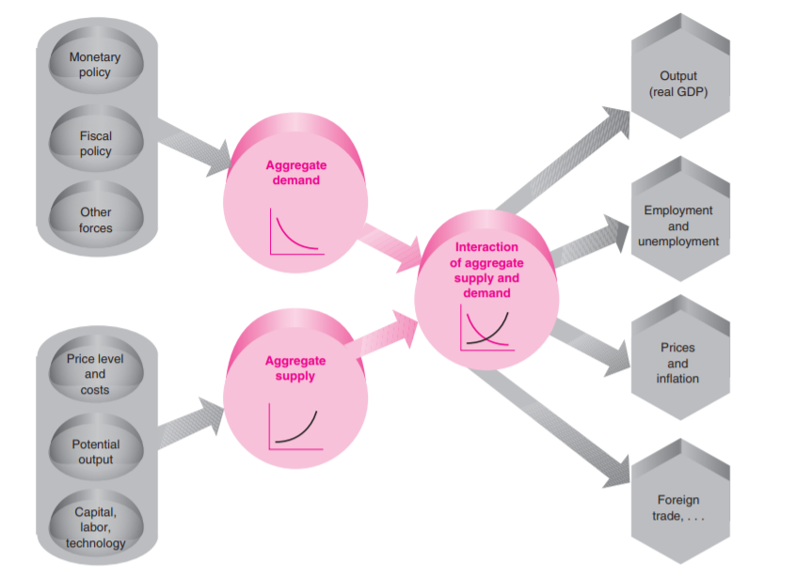
Aggregate Supply and Aggregate Demand determine major macroeconomic variables (Ref: Samuelson & Nordhaus: Economics, 19th Ed.)

Slide 10
AD-AS model
Basic macroeconomic tool for studying output fluctuations and determination of price levels and inflation rate in the short-run
Tool to understand why economy deviates from path of smooth growth over time; and explore consequences of government policies intended to smooth output fluctuations, reduce unemployment and maintain price stability
HS101 – Economics (Macroeconomics) - 2019

Slide 11
Aggregate Demand
Aggregate demand (AD): Represents the total output that would be willingly bought at every price level, other factors (drivers of demand, fiscal and monetary policies) held constant.
AD: Total planned or desired spending in the economy (on consumption, private domestic investment, government expenditure and net exports) during a given period.
Determined by the aggregate price level, and domestic investment, net exports, government spending, consumption and money supply.
AD curve: Graphs the relation between the quantity of goods and services that people are willing to buy at any aggregate price level, other things equal; with the dynamics driven by government spending, consumption function and money supply.
HS101 – Economics (Macroeconomics) - 2019

Slide 12
Aggregate Demand Components
Consumption: Determinants of C – disposable income, long-run trends in income, wealth, aggregate price level
AD focuses on determinants of real consumption.
Investment: Determinants of I – Output level, cost of capital, business expectations.
Major economic policy affecting investment: monetary policy
Government expenditure: Determined by government purchases which add directly to the GDP
Net exports (NX):
Determinants of exports: Foreign incomes and outputs, relative prices, and foreign exchange rates
Determinants of imports: Domestic income and output, exchange rates (ratio of domestic to foreign prices), and by the foreign exchange rate of the dollar
Determinants of NX: domestic and foreign outputs, relative prices, and exchange rates
HS101 – Economics (Macroeconomics) - 2019

Slide 13
AD curve
AD curve: gives the quantity of output (real GDP) demanded (willingly bought) at various price levels.
Relation between the quantity of goods and services that people are willing to buy at the aggregate price level, other things equal.
Why downward sloping?
Factors which do not rise with price; or fixed in nominal terms
Real spending declines with higher price level primarily due to effect of higher prices on real incomes and wealth
↑ price levels => ↓ real disposable income (thus, real consumption expenditure)
↑ price levels => ↓ real value of wealth (thus, real consumption expenditure)
Movement along the AD curve:
Higher price levels (other factors remaining constant) => fall in real disposable income => fall in real spending
HS101 – Economics (Macroeconomics) - 2019

Slide 14
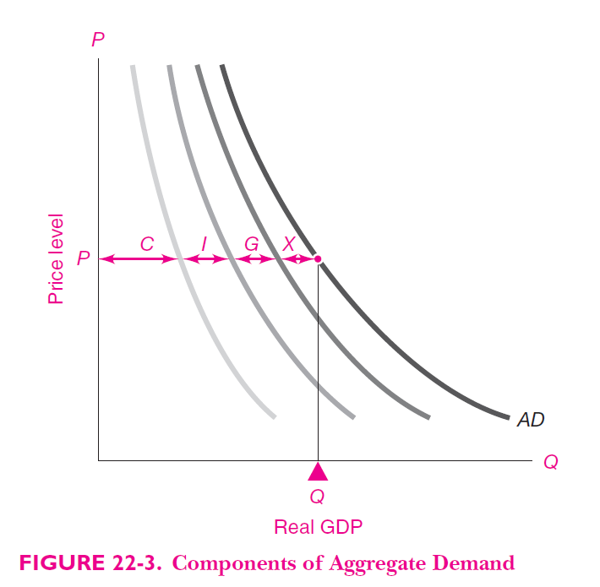
Constructing the AD curve
AD @ given price level P
= sum of the 4 spending streams @ P
Ref: Samuelson & Nordhaus: Economics, 19th Ed.

Slide 15
Shifts in the AD curve
Policy variables:
Monetary policy – Money supply (M^{ss}), interest rates (i)
Fiscal policy – Government expenditure (G), taxes (T)
Exogenous variables: foreign output, asset values, technology advances, other factors (political, international trade policies, wars, etc.)
Variable | Impact on AD
Monetary policy | (Expansionary)↑Money supply ↓ interest rates => ↑ credit availability ↑ investment and consumption => AD shifts out
Fiscal policy | ↑ Government spending => ↑ spending => AD shifts out ↑ Taxes => ↓ Disposable income => ↓ consumption => AD shifts left
Foreign output | ↑ Foreign output growth => ↑ NX => AD shifts out
Asset values | ↑ Stock prices => ↑household wealth (and ↓ cost of capital) => ↑ consumption => ↑ investment => AD shifts out
Technological advances | Technological advances (e.g. mobile, computers, etc.) => ? => AD shifts out
Others | E.g. positive oil price shocks, end of wars, good monsoon => AD shifts out

Slide 16
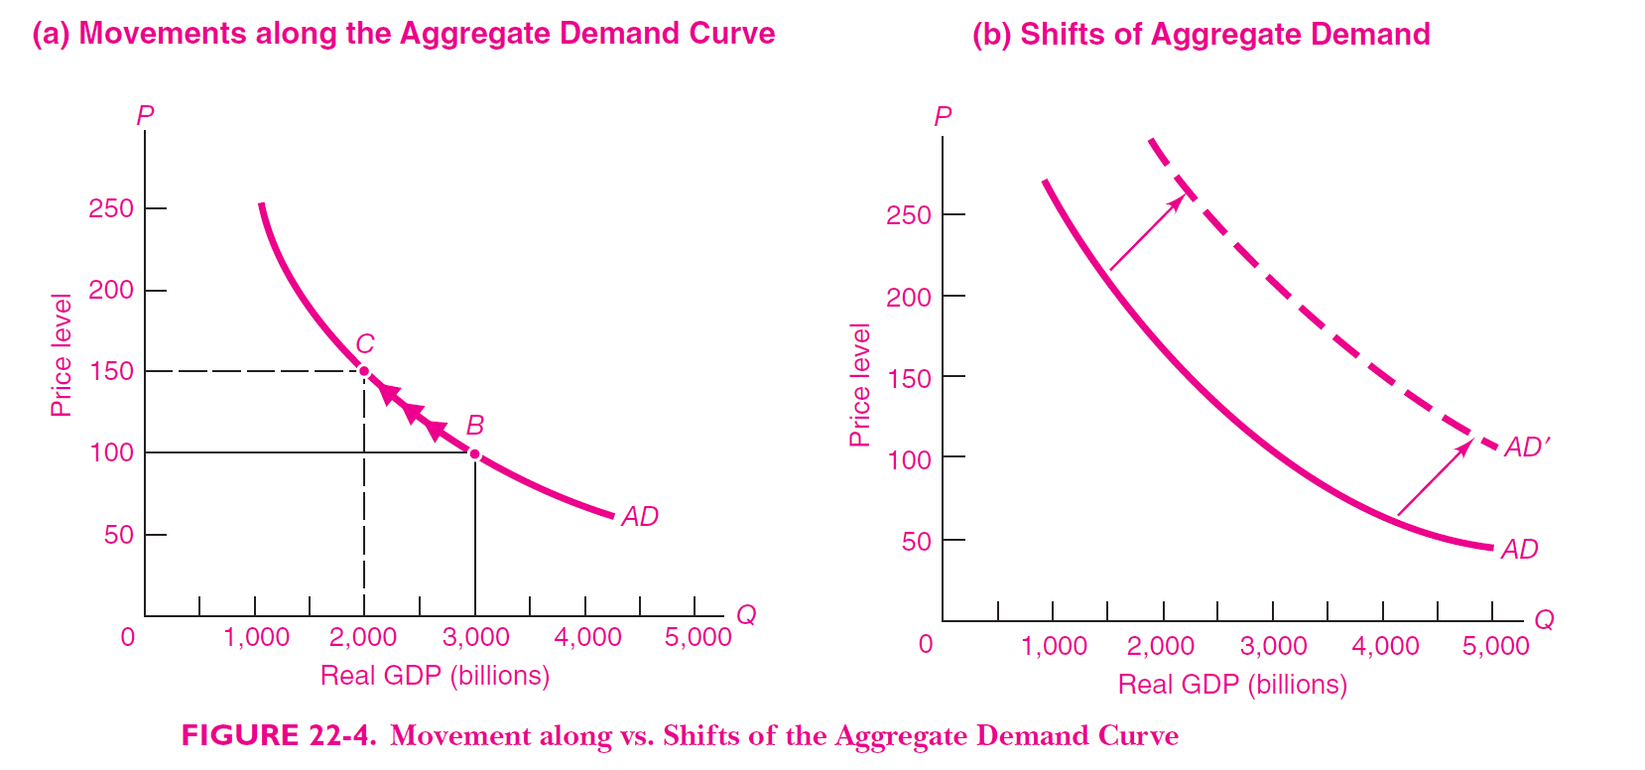
Shifts along and in the AD curve
HS101 – Economics (Macroeconomics) - 2019

Slide 17
Multiplier model
Economies experience business cycles (short-run)
How do changes in spending translate to changes in output and employment?
How do changes in aggregate demand (AD) affect national output?
Multiplier model
Simplest approach
Macroeconomic theory used to explain output determination in the short-run
“Multiplier”:
A Rupee change in Investment (or exogenous expenditures)
more than proportional (or multiplied) change in GDP
Impact of shocks to I, G, tax on GDP in an economy with unemployed resources
HS101 – Economics (Macroeconomics) - 2019

Slide 18
Assumptions
Prices and wages are fixed in the short-run
All adjustments to shocks or economic policies take place through output and employment (AS curve is flat)
Unemployed resources exist in the economy
No role of monetary policy & financial markets (simplifying assumption)
No international trade and finance (Closed)
Simplified model (as impossible that prices and wages do not react to business conditions in short-run)
2 components
Output determined by consumption and investment through impact on incomes (total expenditure approach)
Calculating the multiplier
HS101 – Economics (Macroeconomics) - 2019

Slide 19
Notations (recall)
C – consumption
S – savings
I – investment (exogenous and constant)
Y – output or GDP
DI – disposable income
B – break-even point (consumption function)
MPC – marginal propensity to consume
MPS – marginal propensity to save
HS101 – Economics (Macroeconomics) - 2019

Slide 20
Output determined by savings and investment
Assume investment is exogenous and constant irrespective of the GDP levels
Recall consumption function and savings function
DI = C + S
Consumption and savings functions are mirror images of each other
Recall the investment schedule (assumption implies a horizontal line)
Superimposing the investment and savings schedules results in the equilibrium level of output, E
HS101 – Economics (Macroeconomics) - 2019

Slide 21
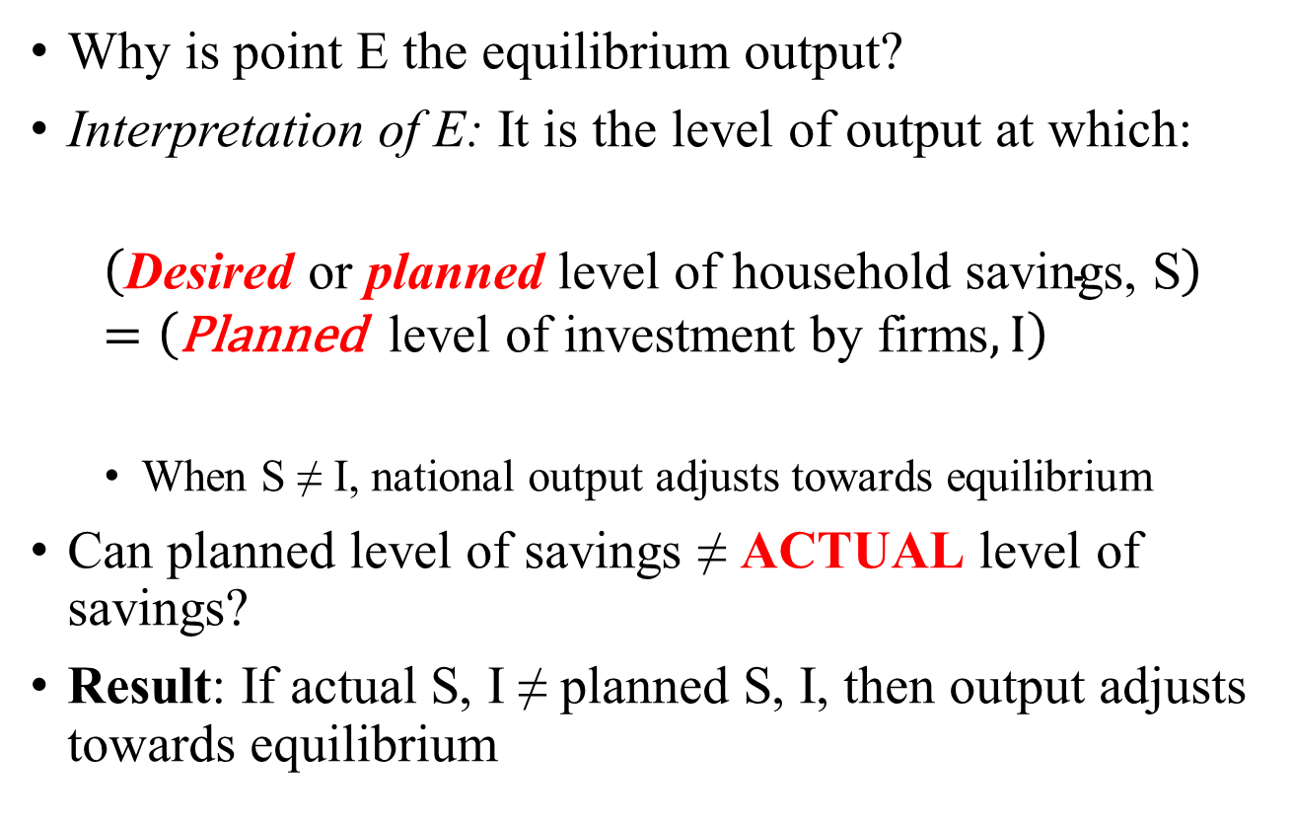
Output determined by savings and investment
Why is point E the equilibrium output?
Interpretation of E: It is the level of output at which:
$$\left(\text{Desired} \text{or} \text{planned} \text{level} \text{of} \text{household} \text{savings}\text{, }\text{S}\right)=\left(\text{Planned} \text{level} \text{of} \text{investment} \text{by} \text{firms}, I\right)$$
When S ≠ I, national output adjusts towards equilibrium
Can planned level of savings ≠ ACTUAL level of savings?
Result: If actual S, I ≠ planned S, I, then output adjusts towards equilibrium
HS101 – Economics (Macroeconomics) - 2019

Slide 22
Total expenditure approach (Output determined by consumption and investment)
Investment and consumption expenditure interact with incomes to determine national output; other exogenous expenditures?
Recall the consumption function: level of desired consumption for every level of DI
Assume no taxes, transfers and other items:
=> DI = National income = GDP (why?)
Assume investment is exogenous and constant irrespective of the GDP levels
Keynesian cross
Graph depicting total expenditure vs. output relationship
Equilibrium:
Output of economy = Total planned expenditure (at point E)
(Graphical: when total expenditure curve crosses 45-degree line)
HS101 – Economics (Macroeconomics) - 2019

Slide 23
The TE model
Assumptions:
A closed economy – no international trade and finance
Unemployed resources exist in the economy
No role of monetary policy & financial markets
Assume investment is exogenous and constant irrespective of the GDP levels
Assume no taxes, transfers and other items (no depreciation, profits, dividends):
=> DI = National income = GDP
HS101 – Economics (Macroeconomics) - 2019

Slide 24
Total expenditure approach
Constructing the Keynesian cross
Construct the consumption function (C curve)
Construct the investment schedule (I curve) (assuming exogenous I implies a horizontal line, say INR 200 billion)
Total planned expenditure (or spending) TE = C + I
Level of desired spending by consumers and businesses corresponding to each level of output
Construct the 45-degree line (at every point on the line, expenditure = output)
Equilibrium level of output, E:
The economy is in equilibrium at the point where the TE = C + I curve crosses the 45° line
The level of desired expenditure on consumption and investment exactly equals level of total output
HS101 – Economics (Macroeconomics) - 2019

Slide 25
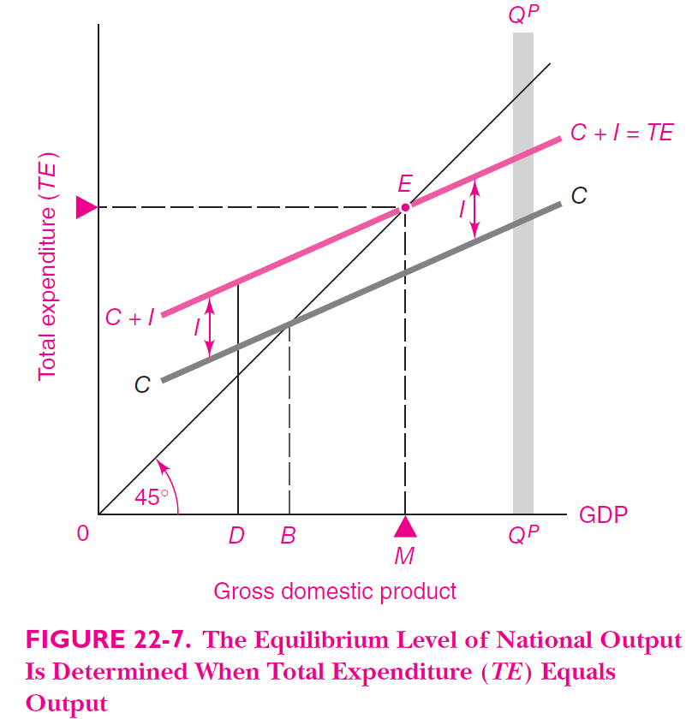
Constructing the Keynesian cross Ref: Samuelson & Nordhaus: Economics, 19th Ed.

Slide 26
Keynesian cross – adjustment mechanism
Equilibrium occurs when planned spending on C and I equals planned output
What if equality does not hold? Dynamics?
Case 1: Planned level of TE is more than output (for that level of TE) (Point D)
Consumers buying more goods than what firms are producing
Firms would increase production
Output would increase till it reaches equilibrium Y
Move right along the TE curve to E
HS101 – Economics (Macroeconomics) - 2019

Slide 27
Keynesian cross – adjustment mechanism
Case 2: Planned level of TE is less than output (for that level of TE) (Point E’ at Y’)
Consumers buying less than what firms are producing
Firms pile up inventories
Firms reduce production
Output would decrease till it reaches equilibrium Y
Move left along the TE curve to E
Case 3: Planned level of TE = output (for that level of TE)
Sales = forecasts
Inventories at planned levels (No increase in profits by increasing production – since planned consumption needs met)
Production, employment, income and spending all remain at the same level
HS101 – Economics (Macroeconomics) - 2019

Slide 28
Keynesian cross
Key result:
The equilibrium level of GDP occurs at point E, where planned spending equals planned production.
At any other output, the total desired spending on consumption and investment differs from the planned production.
Any deviation of plans from actual levels will cause businesses to change their production and employment levels, thereby returning the system to the equilibrium GDP.
HS101 – Economics (Macroeconomics) - 2019

Slide 29
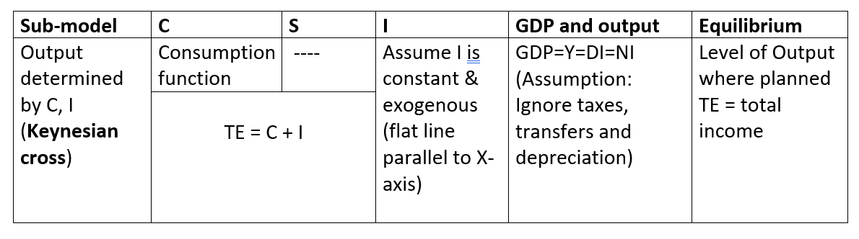
Summary of TE model
HS101 – Economics (Macroeconomics) - 2019

Slide 30
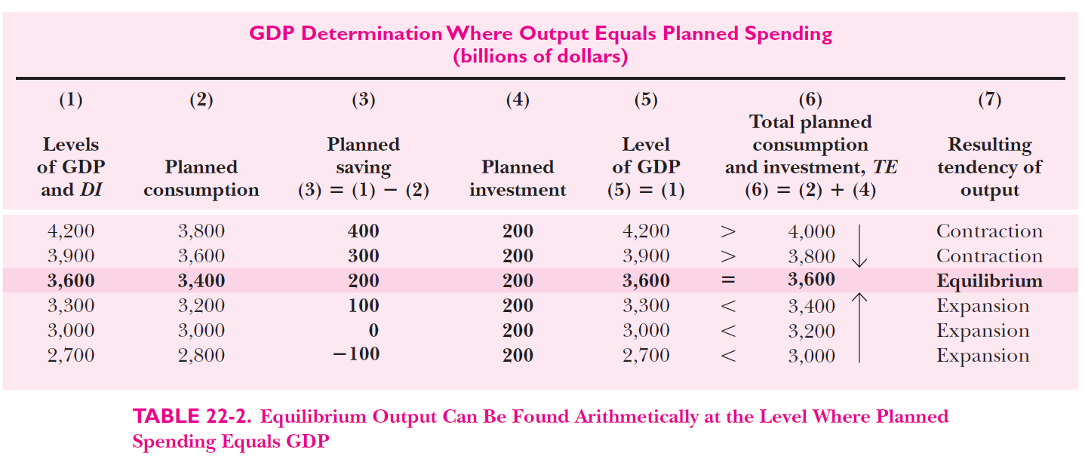
Arithmetic example Ref: Samuelson & Nordhaus: Economics, 19th Ed.
HS101 – Economics (Macroeconomics) - 2019

Slide 31
The Multiplier model
How does change in exogenous investment spending impact GDP (magnitude)?
Multiplier model shows that an increase in investment will increase GDP by an amplified or multiplied amount—by an amount greater than itself.
Multiplier is the impact of a one Rupee change in exogenous expenditures (such as I, G, etc.) on total output.
In the simple C+I model (above), the multiplier is the ratio of the change in total output to the change in investment (which is the exogenous expenditure).
NOTE: The same approach can be used to determine the effect of changes in other exogenous expenditures such as government expenditures, exports, and other items on total output.
HS101 – Economics (Macroeconomics) - 2019

Slide 32
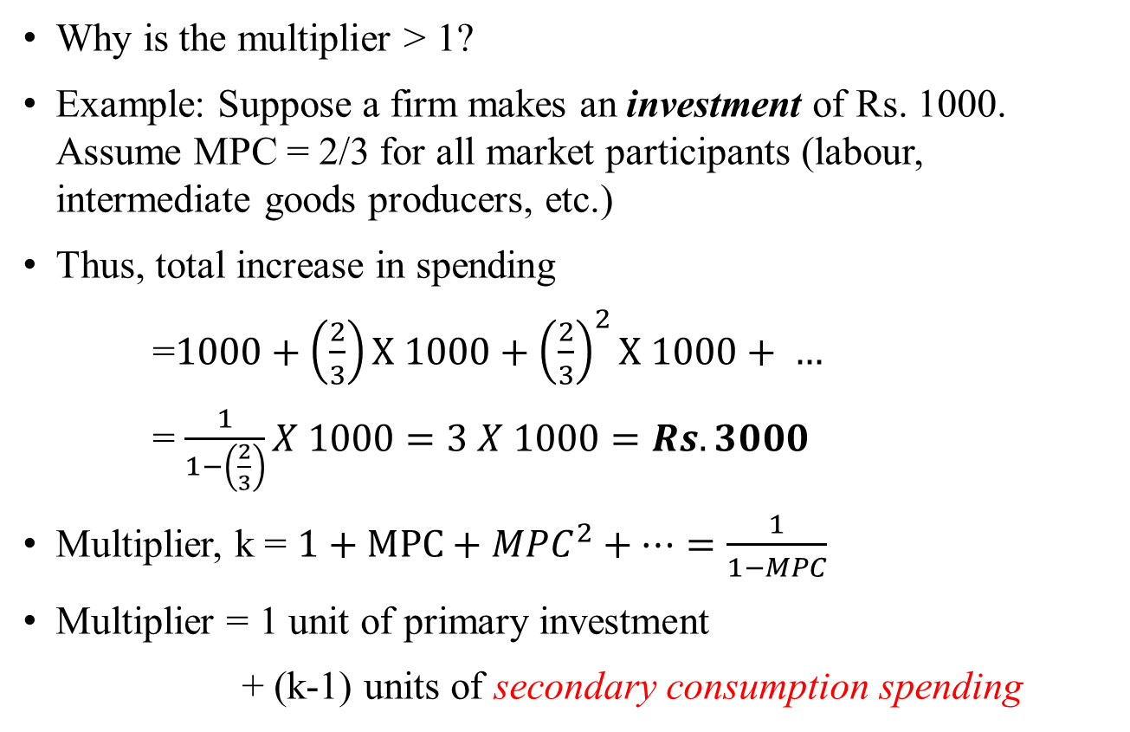
Calculating the multiplier
Why is the multiplier > 1?
Example: Suppose a firm makes an investment of Rs. 1000. Assume MPC = 2/3 for all market participants (labour, intermediate goods producers, etc.)
Thus, total increase in spending
=$1000+\left(\frac{2}{3}\right)X 1000+{\left(\frac{2}{3}\right)}^{2}X 1000+ …$
= $\frac{1}{1−\left(\frac{2}{3}\right)}X 1000=3 X 1000=Rs.3000$
Multiplier, k = $1+MPC+{MPC}^{2}+…=\frac{1}{1−MPC}$
Multiplier = 1 unit of primary investment
+ (k-1) units of secondary consumption spending
HS101 – Economics (Macroeconomics) - 2019

Slide 33
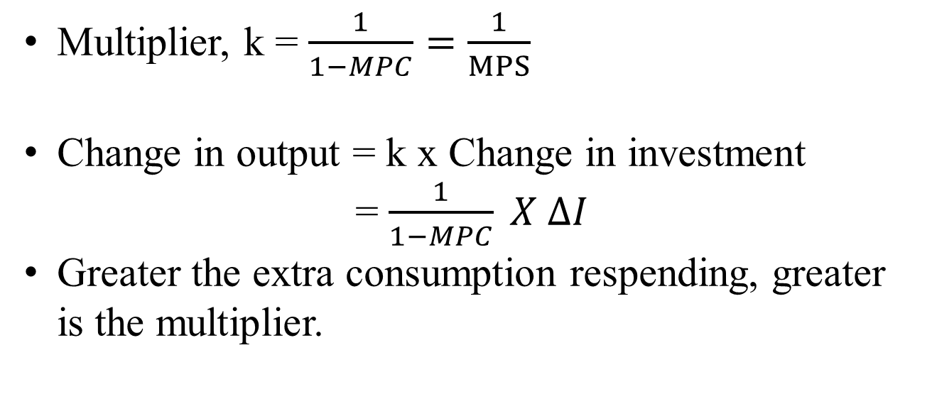
Calculating the multiplier
MPS | MPC | Multiplier, k
1/3 | 2/3 | 3
1/4 | 3/4 | 4
1/2 | 1/2 | 2
1/x | 1 – (1/x) | x
Multiplier, k = $\frac{1}{1−MPC}=\frac{1}{MPS}$
Change in output = k x Change in investment
= $\frac{1}{1−MPC} X ∆I$
Greater the extra consumption respending, greater is the multiplier.
HS101 – Economics (Macroeconomics) - 2019

Slide 34
Relation between AD-AS and the multiplier model
Multiplier model is a special case of the AD-AS model dealing with impact of consumption and investment spending on AD under the assumption that prices and wages are fixed in the short-run (though simplified, some prices are sticky which results in adjustments to AD through output adjustments)
Closed economy version of AS-AD model
Both approaches lead to the same equilibrium level of output
AS-AD equilibrium: The equilibrium is the intersection of the AD curve and the AS curve at point E. Since wages and prices are assumed fixed, the AS curve is horizontal until full employment is reached and becomes completely vertical when output level equals potential output.
Drawback of multiplier model: Period of full employment
HS101 – Economics (Macroeconomics) - 2019

Slide 35
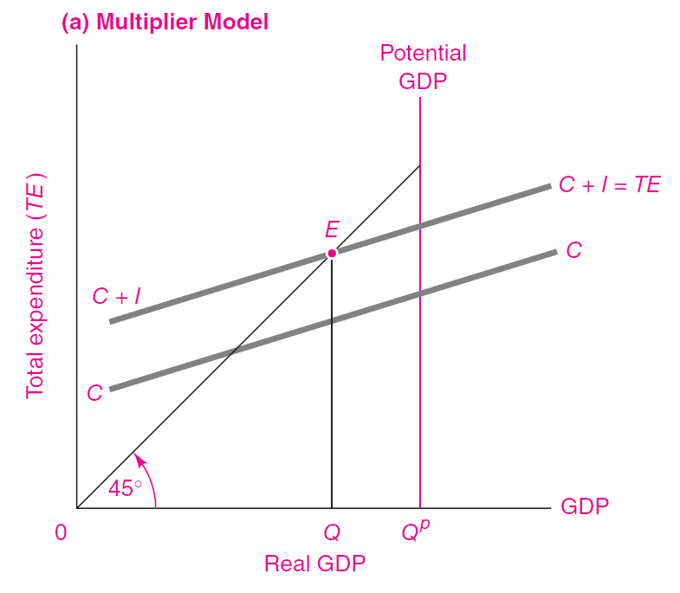
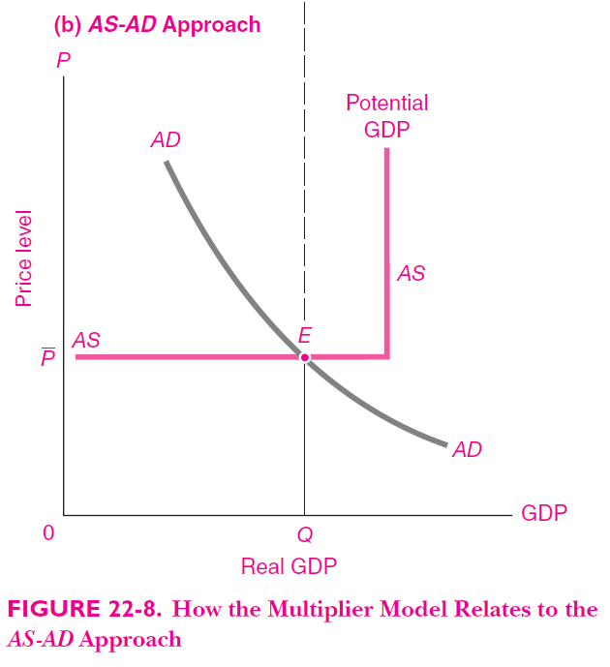
Relation between AD-AS and the multiplier model Ref: Samuelson & Nordhaus: Economics, 19th Ed.
HS101 – Economics (Macroeconomics) - 2019

Slide 36
Thank You

